Slide 1
Balanced Binary Search Trees
Tengjun Liu

Slide 2
Binary Search Trees

Slide 3
What is a binary search tree (BST)?
Formal definition:
An empty tree is a BST
If the left subtree of a node isn’t empty, then all its values are less than the node’s value
If the right subtree of a node isn’t empty, then all its values are greater than the node’s value
The left and right subtrees of a node are both BSTs

Slide 4
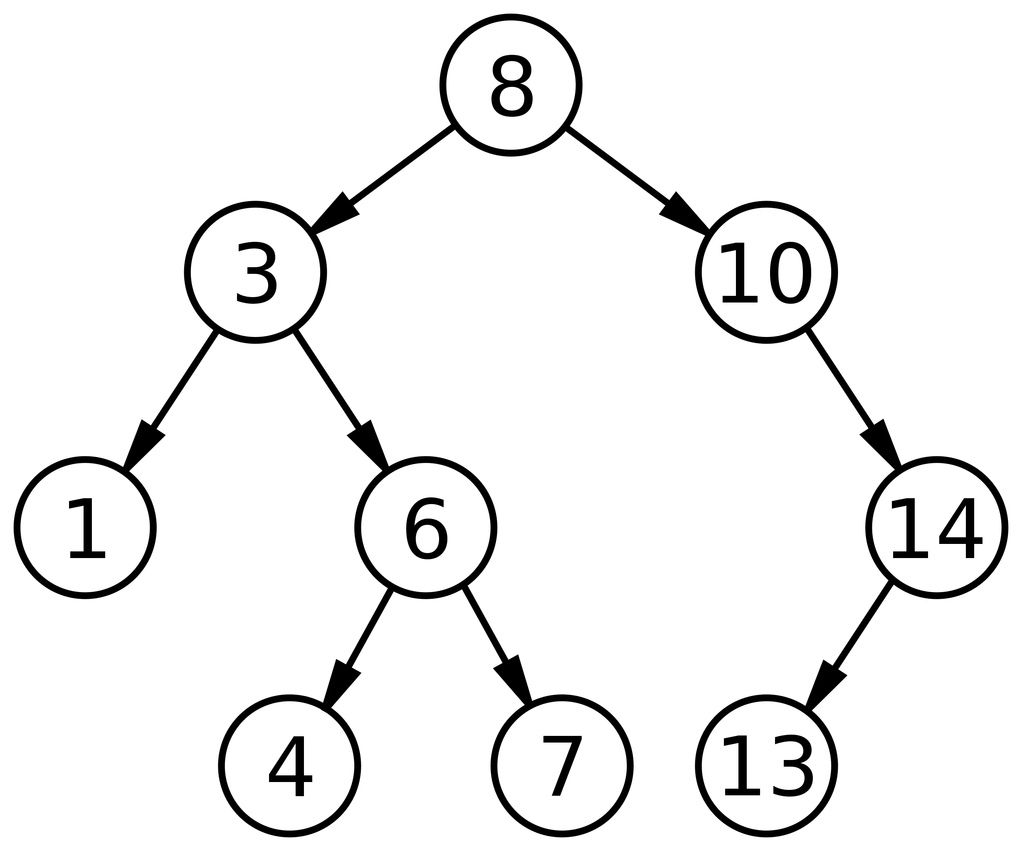

Slide 5
struct Node
{
int value;
Node* lc;
Node* rc;
int size, height;
Node(int v): value(v), lc(nullptr), rc(nullptr), size(1), height(1){}
};

Slide 6
Operations of a BST
Searching
Predecessor/successor
Maximum/minimum
Insertion
Removal
Traversal
Rank
Select

Slide 7
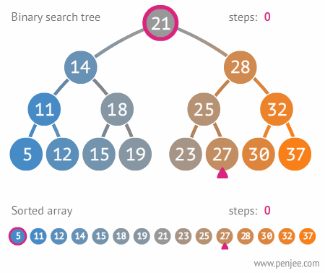
Searching
If key is less than node, search its left subtree
If key is greater than node, search its right subtree
If key is equal to node, return node
If node is non-existent, the key doesn’t exist
Node* find(Node* cur, int v)
{
if (cur == nullptr) return nullptr;
if (cur->value < v) return find(cur->rc, v);
if (cur->value > v) return find(cur->lc, v);
return cur;
}

Slide 8
Maximum/minimum
Maximum:
Travel down right children until reach null
Minimum:
Travel down left children until reach null
Node* max(Node* cur)
{
if (cur->rc != nullptr) return max(cur->rc);
return cur;
}
Node* min(Node* cur)
{
if (cur->lc != nullptr) return max(cur->lc);
return cur;
}

Slide 9
Insertion
If key is less than node, insert into left subtree
If key is greater than node, insert into right subtree
If node doesn’t exist, create new node with key value here
Node* insert(Node* cur, int v)
{
if (cur == nullptr) return new Node(v);
if (cur->value < v) cur->rc = insert(cur->rc, v);
else cur->lc = insert(cur->lc, v);
return cur;
}

Slide 10
Removal
Use aforementioned methods to find node
If is leaf, remove
If has one child, replace with child
If has two children, replace with left child and make right child the right child of the max in left subtree
Node* remove(Node* cur, int v)
{
if (cur == nullptr) return nullptr;
if (cur->value < v) cur->rc = remove(cur->rc, v);
else if (cur->value > v) cur->lc = remove(cur->lc, v);
else
{
if (cur->lc == nullptr && cur->rc == nullptr) cur = nullptr;
else if (cur->lc != nullptr && cur->rc == nullptr) cur = cur->lc;
else if (cur->lc == nullptr && cur->rc != nullptr) cur = cur->rc;
else cur = max(cur->lc);
}
return cur;
}

Slide 11
Traversal
Traverse left subtree
Print node
Traverse right subtree
void traverse(Node* cur, vector<int>* vec)
{
if (cur->lc != nullptr) traverse(cur->lc, vec);
vec->push_back(cur->value);
if (cur->rc != nullptr) traverse(cur->rc, vec);
return;
}

Slide 12
Rank
Rank is number of nodes before it + 1
int rnk(Node* cur, int v)
{
if (cur == nullptr) return -1;
if (cur->value > v) return rnk(cur->lc, v);
if (cur->value < v) return rnk(cur->rc, v) + cur->lc->size + 1;
return (cur->lc != nullptr ? cur->lc->size : 0) + 1;
}
Notes:
Rank starts from 1.

Slide 13
Selection
If rank <= size of left subtree, select in left subtree
If rank > 1 + size of left subtree, select in right subtree and subtract 1 + size of left subtree from rank
Otherwise, current node is at rank
Node* select(Node* cur, int rank)
{
if ((cur->lc != nullptr ? cur->lc->size : 0) >= rank) return select(cur->lc, rank);
if ((cur->lc != nullptr ? cur->lc->size : 0) < rank-1) return select(cur->rc, rank - (cur->lc != nullptr ? cur->lc->size : 0) - 1);
return cur;
}
Notes:
Rank starts from 1.

Slide 14
But languages implement BSTs!
Data structures like map and set (C++), TreeMap and TreeSet (Java), etc. are based on BSTs
So why write our own?
They don’t have rank and selection!
Notes:
Rank starts from 1.

Slide 15
Balanced Binary Search Trees

Slide 16
Time complexity of BSTs
Searching related operations: O(log(n))
Insertion: O(log(n))
Removal: O(log(n))
… in theory
Notes:
Rank starts from 1.

Slide 17
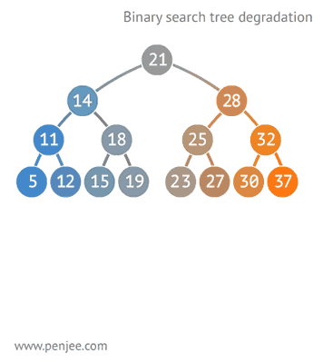
So what’s wrong?
BSTs can be very imbalanced
An unbalanced BST could have a time complexity of O(n) for its operations
Trees need to be self-balancing to create balanced binary search trees (BBST)
Notes:
Rank starts from 1.

Slide 18
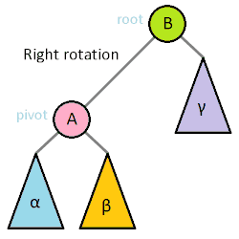
Rotation
Changes the relationship between a parent-child pair
Still preserves the properties of a binary tree
Notes:
Rank starts from 1.

Slide 19
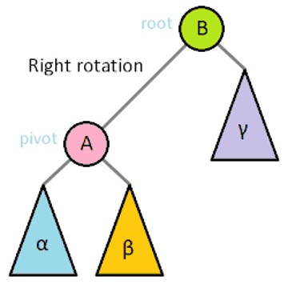
Rotation
Right rotation (just reverse left-right for left rotation):
Changes right child of old child into left subtree of old parent
Changes old parent into right child of old child
Returns child (to become child of the grandparent)
Node* rRotate(Node* cur)
{
Node* left = (*cur).lc;
(*cur).lc = (*left).rc;
(*left).rc = cur;
(*cur).height = fmax(((*cur).lc != nullptr ? (*(*cur).lc).height : 0), ((*cur).rc != nullptr ? (*(*cur).rc).height : 0)) + 1;
(*cur).size = ((*cur).lc != nullptr ? (*(*cur).lc).size : 0) + ((*cur).rc != nullptr ? (*(*cur).rc).size : 0) + 1;
(*left).height = fmax(((*left).lc != nullptr ? (*(*left).lc).height : 0), ((*left).rc != nullptr ? (*(*left).rc).height : 0)) + 1;
(*left).size = ((*left).lc != nullptr ? (*(*left).lc).size : 0) + ((*left).rc != nullptr ? (*(*left).rc).size : 0) + 1;
return left;
}
Notes:
Rank starts from 1.

Slide 20
Types of BBST
Red-black trees
AVL trees
Scapegoat trees
Treaps
Notes:
Rank starts from 1.

Slide 21
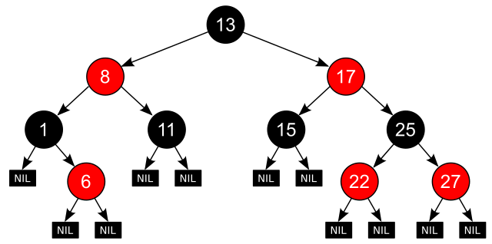
Red-black tree
All nodes are labelled red or black
The root is black
The leaves are “null” and are labelled black
The children of red nodes must be black
On every path from the root to a leaf node, the number of black nodes are the same
Notes:
Rank starts from 1.

Slide 22
Properties
Reasonably fast search
Worst case is O(2log(n)), which is still logarithmic
Fast insertion
Only occasionally need rotations
… but you don’t really need to know it
Very hard to implement
Multitudes of subcases for operations
Notes:
Rank starts from 1.

Slide 23
AVL trees
A strictly balanced BST
Difference in height between subtrees is at most 1
Need to keep track of node heights
Very fast query
Somewhat slower insertion (but still logarithmic)
Requires frequent rotations to maintain balance
A bit easier to implement than red-black trees
Notes:
Rank starts from 1.

Slide 24
AVL tree maintenance
Since only one node is inserted/removed, the difference in heights is at most 2
However, we need to recursively maintain the properties at every single node, which makes things slow
Notes:
Rank starts from 1.

Slide 25
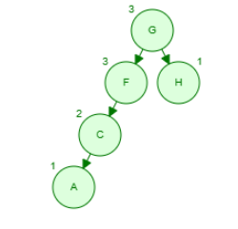
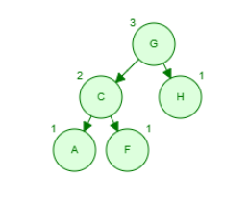
Right rotation
Notes:
Rank starts from 1.

Slide 26
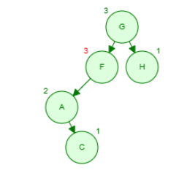
Left-right rotation
Notes:
Rank starts from 1.

Slide 27
Node* maintain(Node* cur)
{
if (cur == nullptr) return nullptr;
int lh = 0, rh = 0;
if ((*cur).lc != nullptr) lh = (*(*cur).lc).height;
if ((*cur).rc != nullptr) rh = (*(*cur).rc).height;
if (abs(lh-rh) > 1)
{
if (lh>rh)
{
int llh = 0, lrh = 0;
if ((*cur).lc != nullptr && (*(*cur).lc).lc != nullptr) llh = (*(*(*cur).lc).lc).height;
if ((*cur).lc != nullptr && (*(*cur).lc).rc != nullptr) lrh = (*(*(*cur).lc).rc).height;
if (llh >= lrh) cur = rRotate(cur);
else
{
(*cur).lc = lRotate((*cur).lc);
cur = rRotate(cur);
}
}
else
{
int rlh = 0, rrh = 0;
if ((*cur).rc != nullptr && (*(*cur).rc).lc != nullptr) rlh = (*(*(*cur).rc).lc).height;
if ((*cur).rc != nullptr && (*(*cur).rc).rc != nullptr) rrh = (*(*(*cur).rc).rc).height;
if (rrh >= rlh) cur = lRotate(cur);
else
{
(*cur).rc = rRotate((*cur).rc);
cur = lRotate(cur);
}
}
}
return cur;
}
Notes:
Rank starts from 1.

Slide 28
Scapegoat trees
Reasonably fast search
Logarithmic, but depends on the ratio constant
Insertion/deletion:
Amortized O(log(n))
Worst case O(n)
But it is really easy to code!
Notes:
Rank starts from 1.

Slide 29
Ratio constant
Usually denoted by α
0.5 < α < 1, usually chosen to be 0.7 to 0.8
It is the maximum percentage a subtree may occupy of the whole tree
i.e., $left subtree size ≤whole tree size × α$ and $right subtree size ≤whole tree size × α$
If one of the subtree sizes gets too big, we reorganize the whole tree
Notes:
Rank starts from 1.

Slide 30
… and how do we reorganize?
Take out the whole tree, store it in an array, and reconstruct it!!!
Node* reorganize(Node* cur)
{
vector<int>* vec;
traverse(cur, vec);
cur = build(vec, 0, (*vec).size());
return cur;
}
// [a, b)
Node* build(vector<int>* vec, int a, int b)
{
if (a >= b) return nullptr;
int mid = (a + b) / 2;
Node* cur = new Node((*vec)[mid]);
cur->lc = build(vec, a, mid);
cur->rc = build(vec, mid+1, b);
return cur;
}
Notes:
Rank starts from 1.

Slide 31
Treaps
Based on heaps
In a heap, every node is smaller (or bigger, depending on what type you’re using) than its children
A treap is a BST and a heap put together
Apart from the value, we also store a random priority
The values follow the structure of a BST, while the priorities follow the structure of a heap
Notes:
Rank starts from 1.

Slide 32
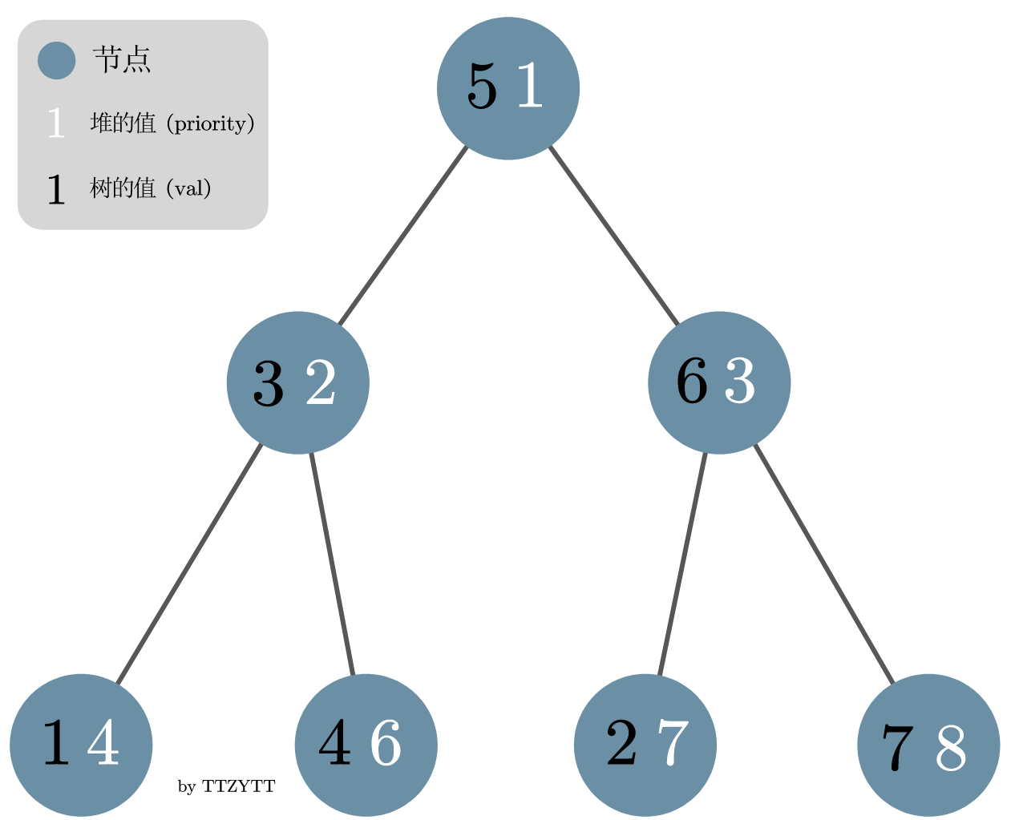

Slide 33
void _insert(Node* cur, int val)
{
if (cur == nullptr)
{
cur = new Node(val);
return;
}
else if (val < cur->value)
{
_insert(cur->lc, val);
if (cur->lc->priority < cur->priority)
{
rRotate(cur);
}
}
else if (val > cur->value)
{
_insert(cur->rc, val);
if (cur->rc->priority < cur->priority)
{
lRotate(cur);
}
}
}

Slide 34
Sources
https://oi-wiki.org/ds/
Rotationless treap: https://oi-wiki.org/ds/treap/#%E6%97%A0%E6%97%8B-treap
Algorithms Illuminated (Part 2) Graph Algorithms and Data Structures by Tim Roughgarden
Algorithms by Robert Sedgewick and Kevin Wayne

Slide 35
Images
https://commons.wikimedia.org/wiki/File:Binary_search_tree.svg
https://commons.wikimedia.org/wiki/File:Binary_search_tree_example.gif
https://commons.wikimedia.org/wiki/File:Binary-search-tree-insertion-animation.gif
https://commons.wikimedia.org/wiki/File:Binary-search-tree-degenerating-demo-animation.gif
https://commons.wikimedia.org/wiki/File:Tree_rotation_animation_250x250.gif
https://commons.wikimedia.org/wiki/File:Red-black_tree_example_with_NIL.svg
https://oi-wiki.org/ds/treap/

